Slide 1

College of Information ai Chatbot – a rag-llm model
Christian Bridge
Chandrasekhar Pedalapu
Pranay Rishith Bondugula

Slide 2
Problem Statement
For a University as large as UNT, it can be extremely difficult for students to find the information that they need outside of scheduling an advising meeting, contacting departments via e-mail or phone, and reading university materials like the Graduate Catalog and scouring different UNT websites.
The main issues can be:
Lack of availability for Academic Advising, which you may need to schedule weeks in advance.
Many different departments, divisions, and colleges which all have varying information structures, provided documents/sources, and different questions.
Time it takes to receive responses via phone or e-mail, and subsequent questions or clarification

Slide 3

The Solution?
Retrieval Augmented Generation – Large Language Models (RAG-LLMs)
RAG-LLMs can:
Use a custom input set of documents
Use different types of embedding models
Use different types of LLMs
Be hosted locally
Have a user-facing, website for accessibility
Generate text based on the input documents to answer user questions

Slide 4
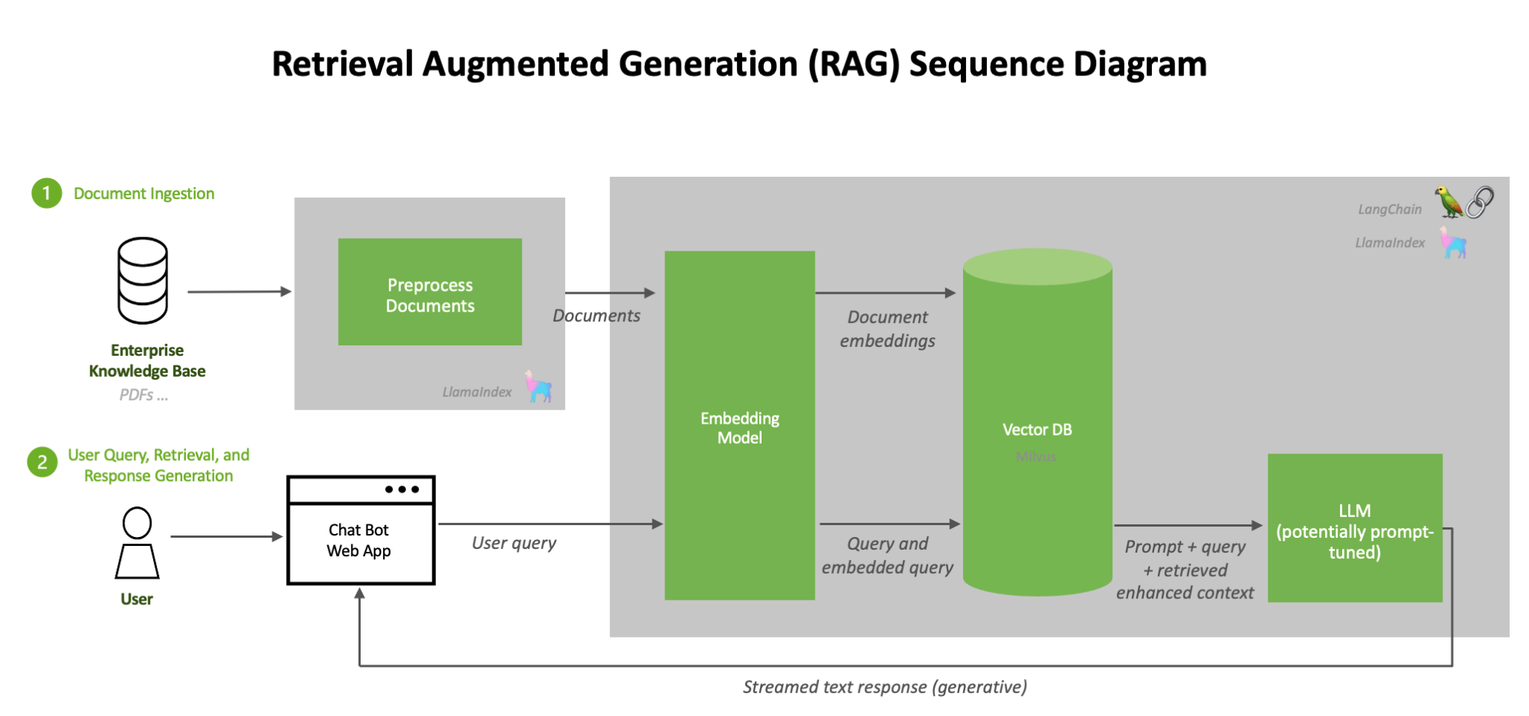
Rag-llm methodology
Obtain data sources.
Manually review data sources.
Parse Data
Create vector embeddings.
Store the vector embeddings.
Engineer LLM prompt.
User queries the system.
Query is turned into vector embeddings.
Most similar context is returned.
Context feeds into the LLM.
LLM generates text.
Human evaluates text.
Figure 1: Overview of RAG pipeline components: ingest and query flows [1]

Slide 5
methodology
Obtain data sources that provide information, answers, or context to help answer questions
Review data sources, pre-process documents, or otherwise clean manually.
Using a data parser, extract all the text from the various data sources, and create a consolidated structure.
Use an embedding model to translate sentences into embedding vectors.
Store the vector embeddings in a database for ease of deployment and querying
Use the same model to embed user queries, and return similar vector embedding results as context.
Use prompt engineering to limit LLM creativity/hallucinations, and act as a specific agent.
Feed the most similar context to the LLM model.
Have the LLM model generate text given the input context.
Compare the results to human results, and have users evaluate.

Slide 6
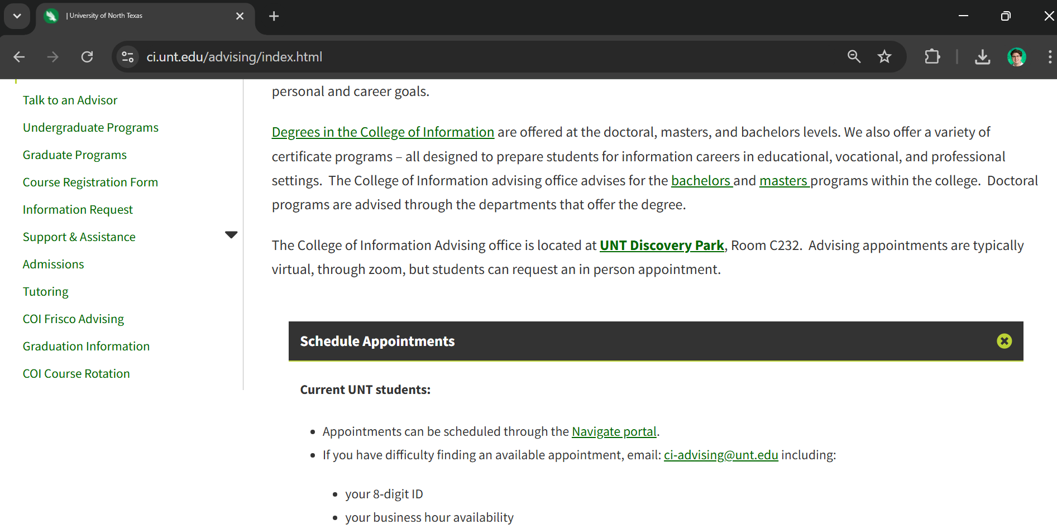
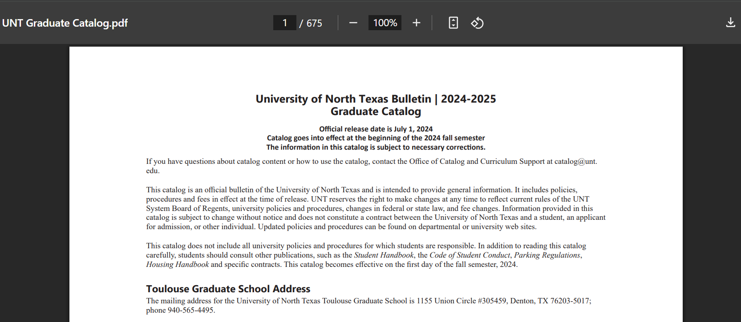
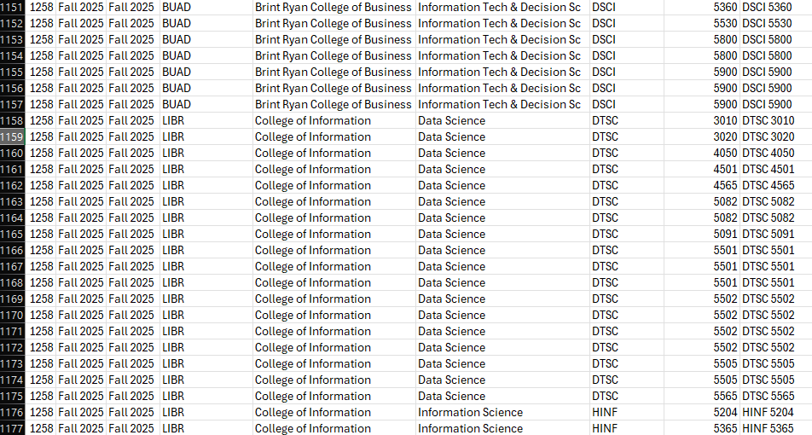
Data sources
Gathering data can be the most time-consuming part of the process because:
You must find valid data
You must clean data
You must figure out how to extract the data
But how can you approach extracting massive amounts of information from different source types, like:
Webpages
PDFs
Excel/CSVs

Slide 7

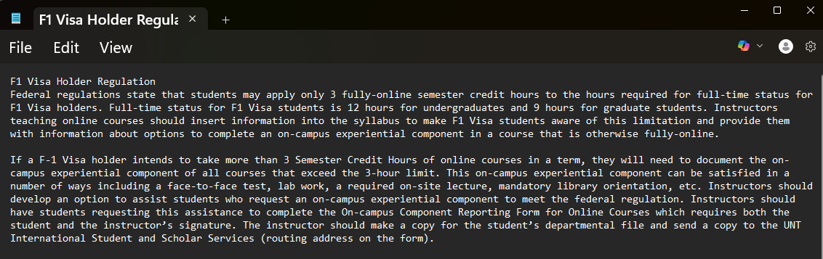
Data handling
Working with Llama Index's SimpleDirectoryReader makes this process a little easier as it can read and parse documents like .pdf, .txt, .json, .pptx, etc.
However, some of the input files like .pptx may include irrelevant information like slide number, be unable to extract information from images, and in the case of PDF files may have difficulty parsing the data correctly depending on formatting.
So while webscrapping, and printing pages as PDF files may work, sometimes to ensure the cleanest information for SimpleDirectoryReader we have to copy and paste to .txt, or creating JSON files.

Slide 8
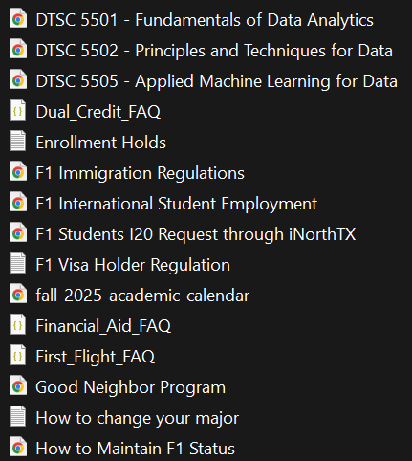
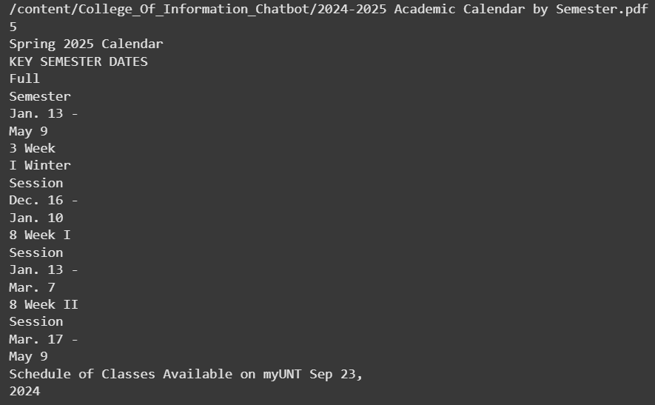
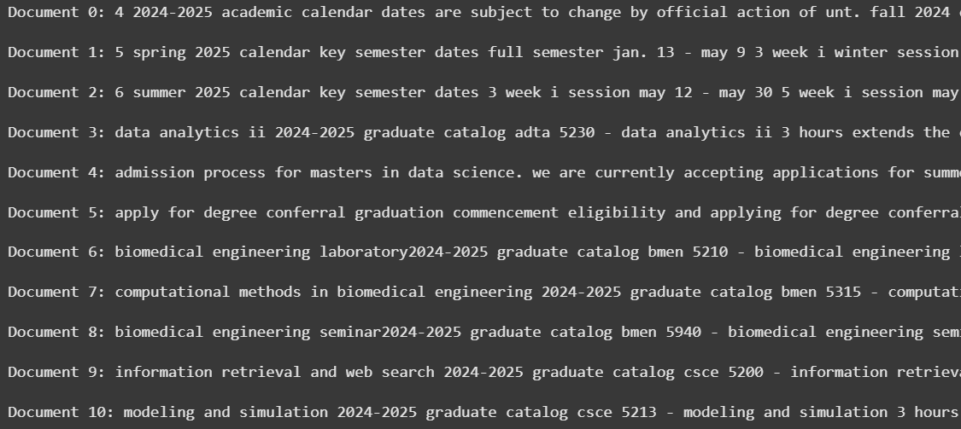
Data Parsing & Preprocessing
Now that we have a set of documents that look to answer our College of Information Advising questions, we can use SimpleDirectoryReader, which will parse all the metadata and texts and store as a Document type.
We can then perform our normal text pre-processing via code such as making all text lowercase, removing multiple line breaks, removing unnecessary special characters, multiple white spaces, and multiple periods in a row.

Slide 9
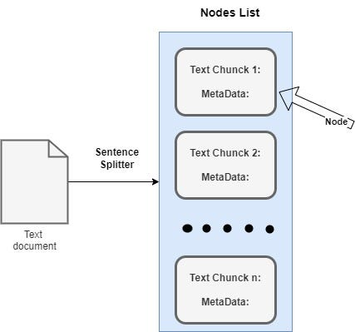
Text Splitting & Chunking
Text splitting is the process of using a criteria to break apart each document's text into chunks of specific lengths (N).
Character Splitting breaks text into chunks of length N characters.
Sentence splitting breaks text into chunks of length N sentences.
More advanced types like Recursive Character Splitter or Semantic Splitter look to break text into chunks of length N, based on line breaks, or sentence semantics, respectively.
For our model we chose to use SentenceSplitter in the Llama Index library, with a chunk size of 512 and an overlap of 50. By using large chunks with a large overlap, we attempt to contain a lot of context within each chunk to keep contextual information and meaning together.
Text splitting and chunking methodologies has the ability to be a whole area of research.
Figure 2: SentenceSplitter splitting text document into multiple chunks stored in nodes [2]

Slide 10
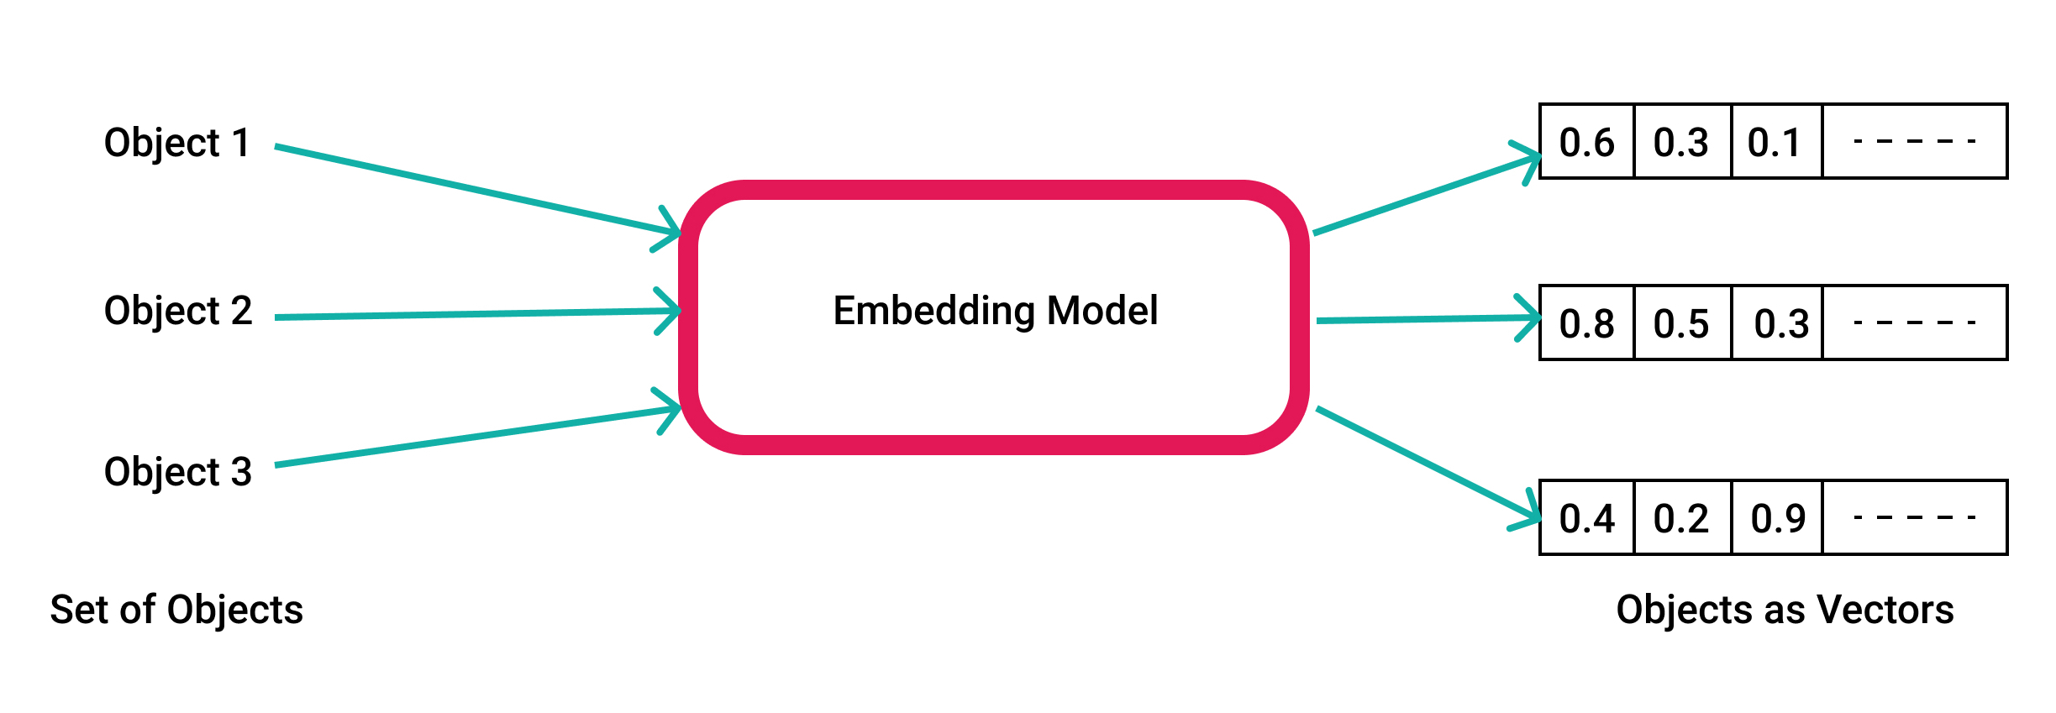
Text Embedding
Text embedding is the process of using a model to translate each word in a chunk to an array of numbers which can be used to determine distance and similarity between each other.
For our project we are using the framework SentenceTransformers with the embedding model BAAI/bge-m3.
Text embedding is used to create embeddings of the data documents, and the user entered question.
Figure 3: Text embedding model workflow [3]

Slide 11
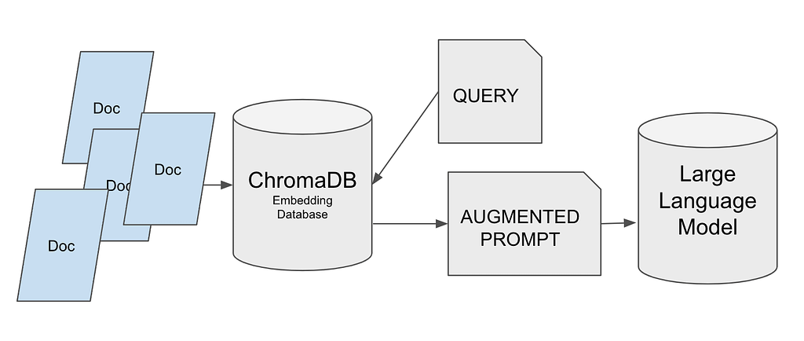
Vector Storage
Once the vector embeddings are created, they will be stored in a database for querying later. For our project we used ChromaDB an open-source embedding database.
This allows the comparison between user query and vector embeddings of documents to be more structured.
Figure 4: ChromaDB workflow [4]

Slide 12

Connecting to a llm
One of the hardest parts of implementation is getting a connection to a LLM model.
LLM models are computationally taxing when running locally
APIs to the largest, newest, and best models can be cost-prohibitive
For running the model, Christian had a desktop with:
64Gb RAM
RTX 4090 24Gb VRAM
For our project we used Meta's Llama 3.3 70b.
Model has 70 billion parameters
Model size is 42Gb

Slide 13
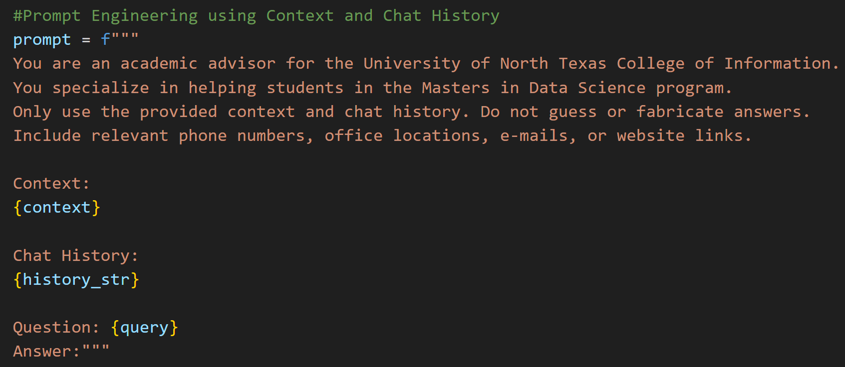
prompt engineering
Engerineering a prompt is important for working with LLMs, especially RAG-LLMS, because:
You want to limit the model using pre-trained information outside of the document set you give it
You want it to act as a particular agent type, like a UNT Academic Advisor
You would like to receive specific formats for output data

Slide 14

User interface
Streamlit provides an easy to program website interface in python. While our project is only available locally, Streamlit also provides options to publish websites for distribution.
We created a User interface using Streamlit so that users do not need to program each individual question, but instead can enter the question via a user-friendly text box, and can see the answer streamed out, time it took to process, and get information about the sources it came from for human evaluation.

Slide 15

Human Evaluation
LLM model output can be hard to evaluate because the output is not a number or classification that can use common metrics like accuracy, f1-score, or Mean Squared Error.
Instead, one option is to use human evaluations, where a human reviews the output of the model to judge how well the LLM performed.
We also obtained baseline answers from a College of Information academic advisor to our questions to compare generated text to.

Slide 16
Human Evaluation
Relevance – Is the response related to the user's question?
Correctness – Is the answer accurate and supported by retrieved context?
Completeness – Does the response cover all the important aspects of the query?
Fluency – Is the language clear, grammatical, and natural?

Slide 17
Evidently AI
Using an AI tool to evaluate some of these metrics and others can speed up the process of evaluations, but can leave reasoning up to another automated model, which may cause errors!
Using Evidently AI we were able to calculate:
Correctness – Compare model response to human given response
Context Quality – Does the context provide information to answer the question?
Faithfulness – Does response stay faithful to context?
Text similarity metrics – are the response words similar in meaning to the human response?
BERT Score & Semantic Similarity

Slide 18
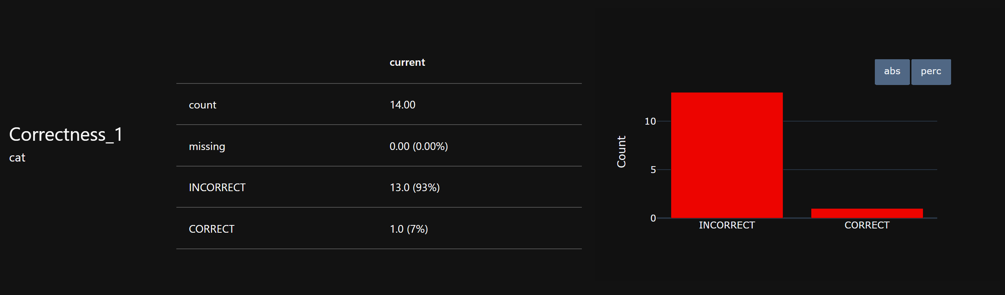
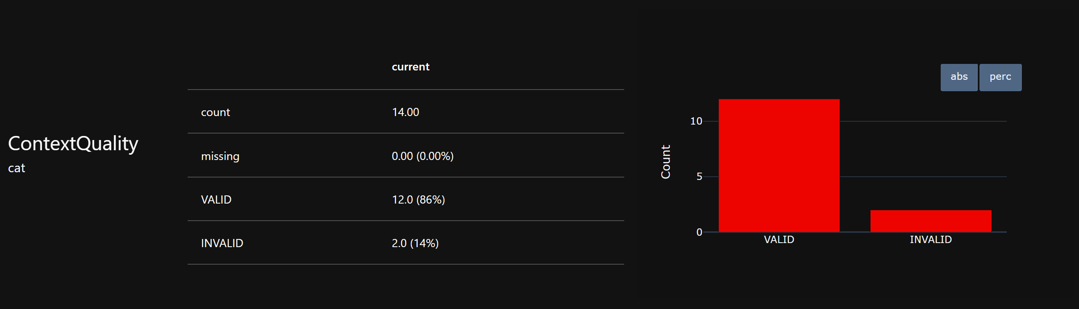
Results
Low because?
Human responses were:
Short
In a condensed time frame
More about getting general info
Dictated
High because?
Our context was able to answer the question in most cases

Slide 19
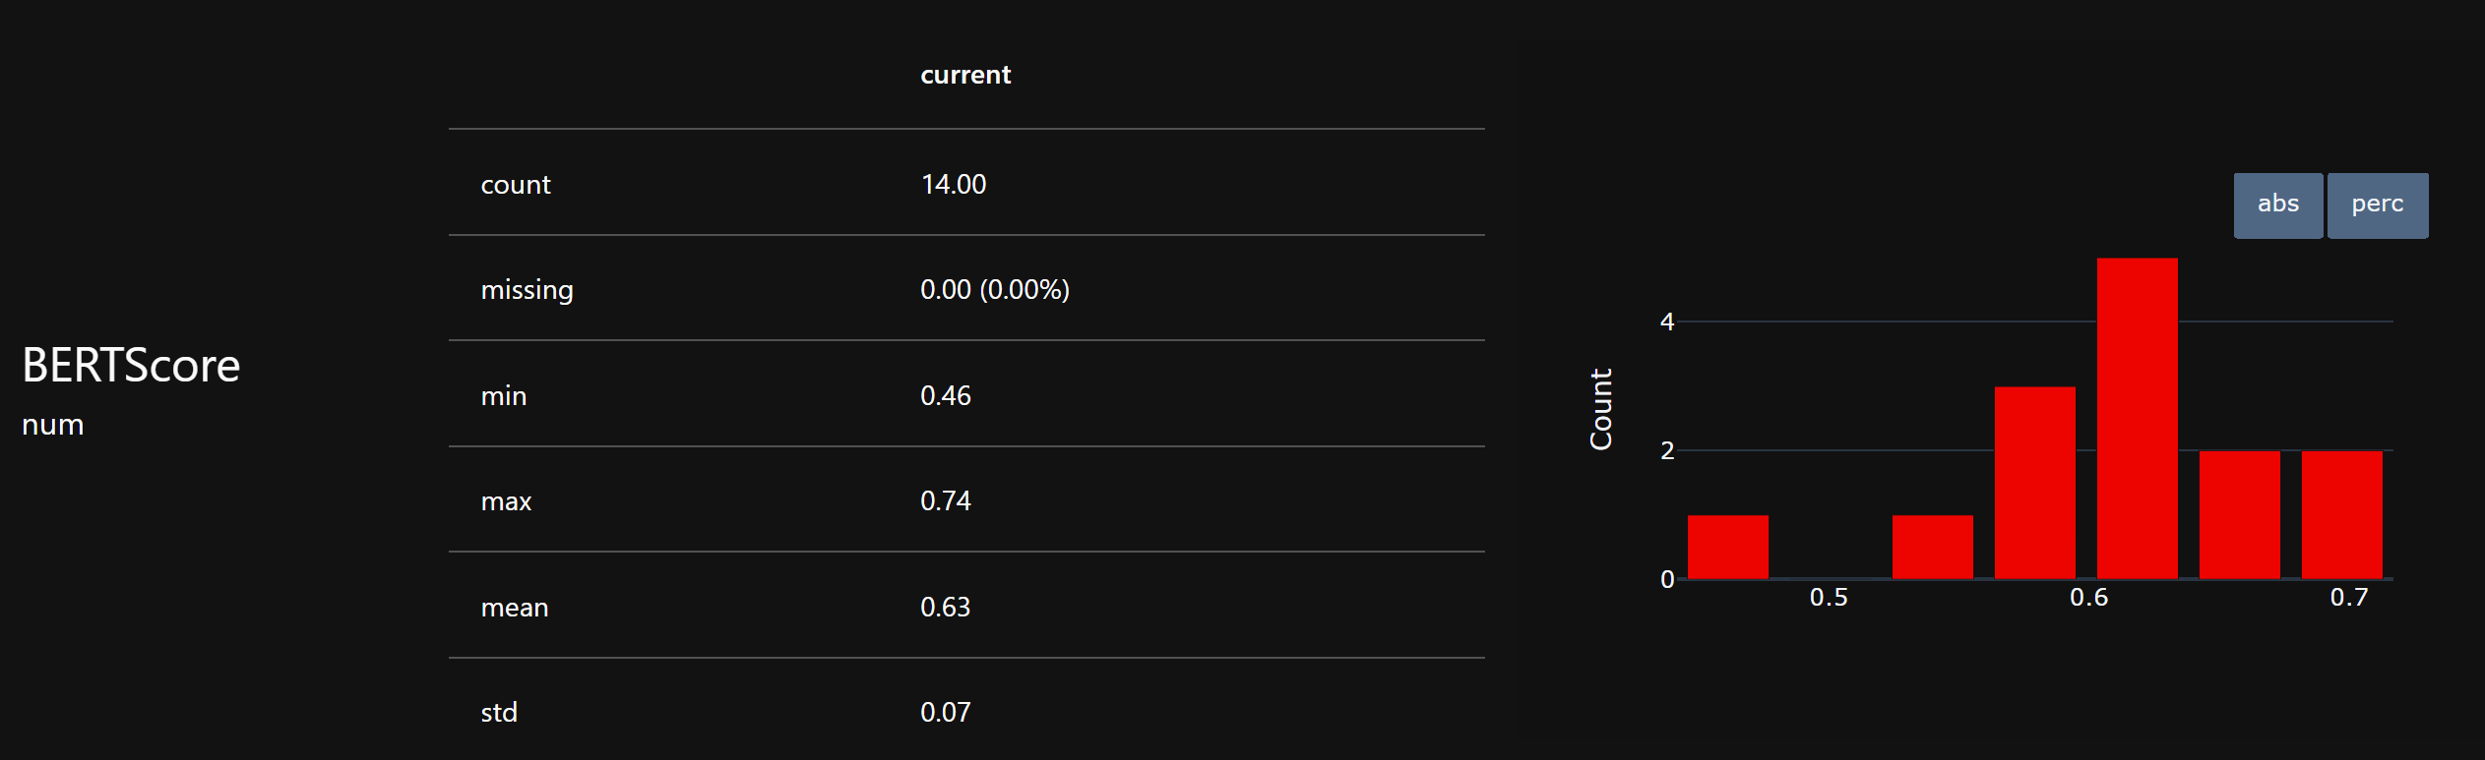
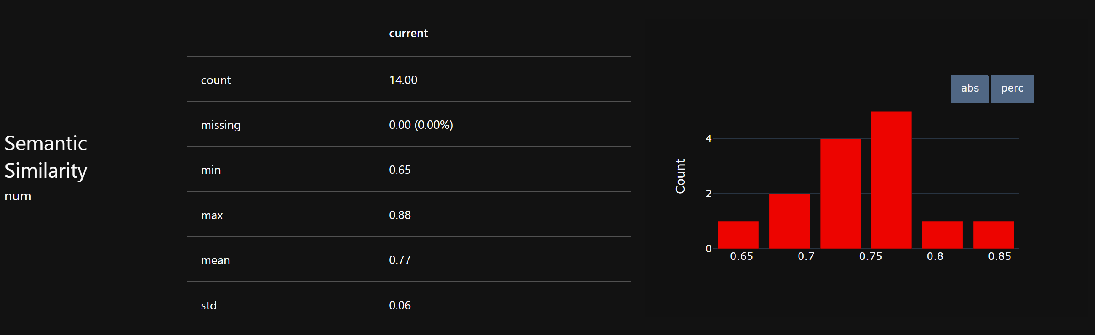
Results
Overall above average score. Possibly lower than semantic similarity because BERT is looking for token-based similarity and can be sensitive to different phrasing.
Overall above average, possibly because it focuses on sentence embedding to convey intent or meaning. It can be skewed by vague or superficially similar sentences though.

Slide 20
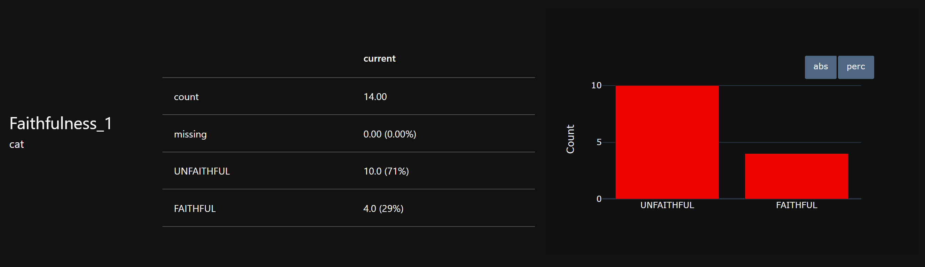
Results
Overall majority of responses were considered unfaithful, which means the generated responses may contain hallucinations and other information that was not provided in the context.
This could also be exacerbated by including chat history in the Prompt Engineering, as chat history was not appended to the context before evaluating for faithfulness.

Slide 21
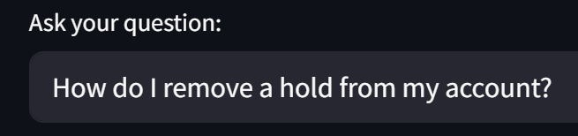
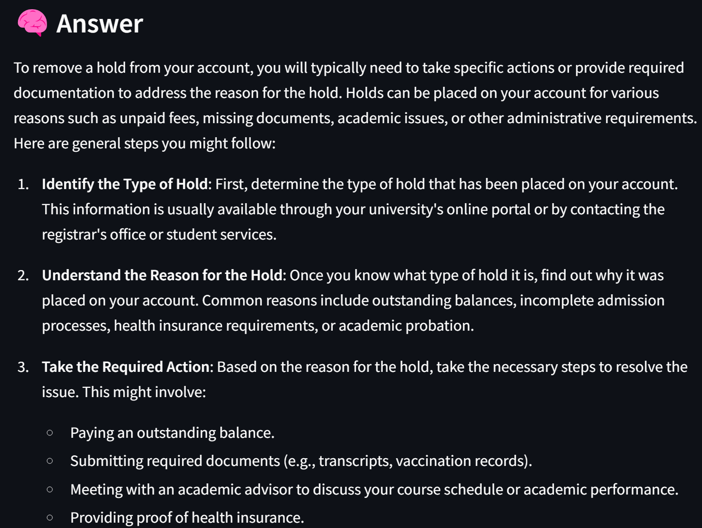
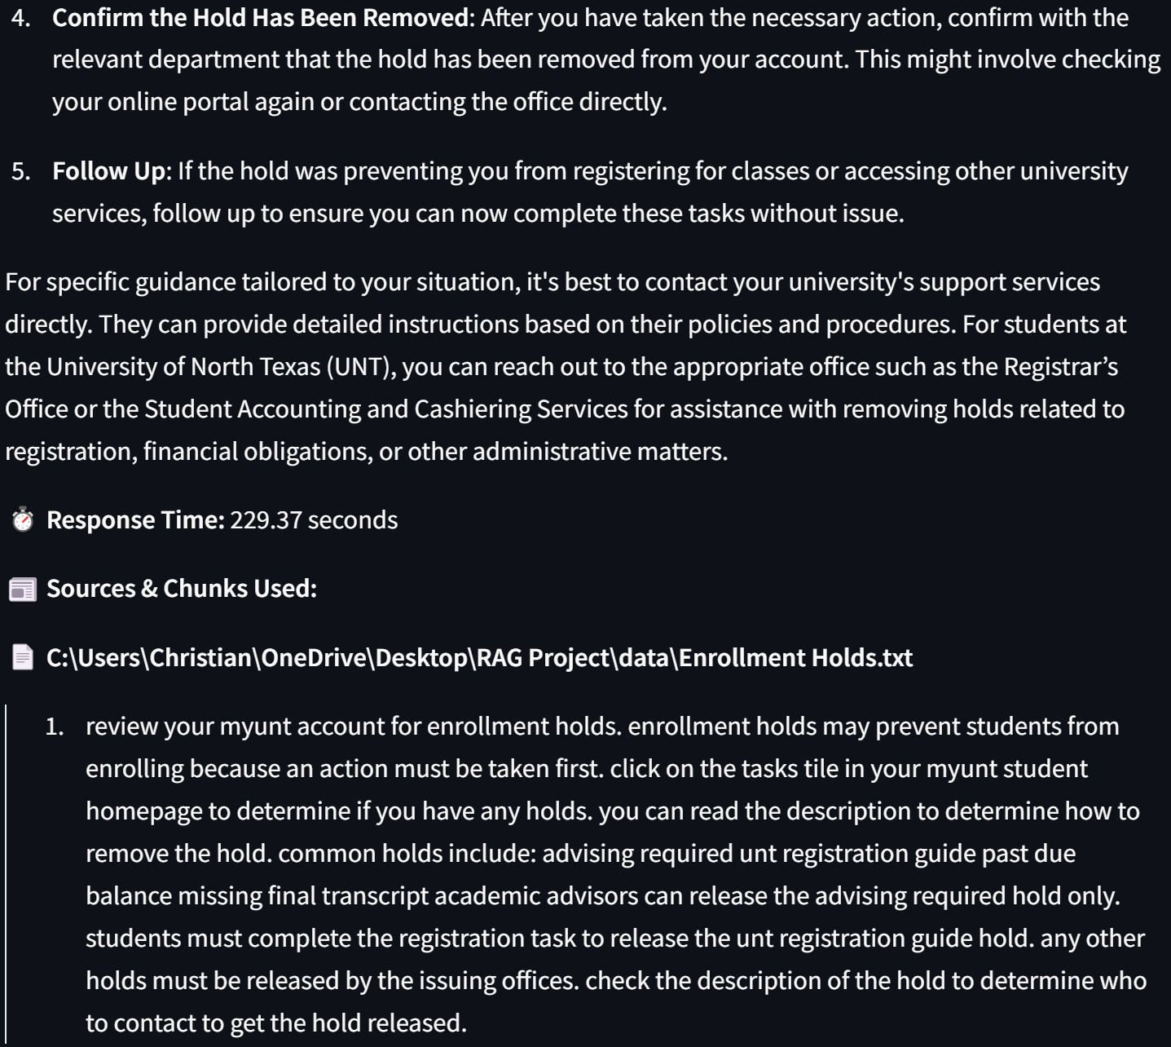
Results

Slide 22
Results
Advisor Response: "This depends on the hold, and which department placed the hold. For instance, if the hold is placed by student accounting, the student will need to contact the student accounting office. Sometimes holds can be released by the student by completing something in their my.unt.edu, however if not, contact the department."
Evidently AI Correctness: Incorrect, The OUTPUT introduces additional claims and step-by-step instructions on how to remove a hold that are not present in the REFERENCE. The REFERENCE specifically mentions contacting the relevant department, particularly student accounting, and that some holds can be released by the student through my.unt.edu. The OUTPUT, however, elaborates further on identifying types of holds, reasons for them, and potential actions to take, which deviates from the original meaning and focus of the REFERENCE.
BERT Score = 0.655 Semantic Similarity = 0.80

Slide 23
Results
Context Quality: Valid.
The text provides clear instructions on how to view and address holds on an account by detailing the steps to log in, check for holds, and contact the relevant offices to remove them. It mentions specific types of holds and who can resolve them, effectively answering the question.
Faithfulness: Unfaithful.
The response provides general steps for removing a hold and adds specific actions that may not be explicitly mentioned in the source, such as providing proof of health insurance and meeting with an academic advisor. Additionally, it does not cite the specific types of holds as outlined in the source, which includes 'advising required', 'UNT registration guide', 'past due balance', and 'missing final transcript'. The response also suggests contacting the Registrar’s Office or Student Accounting and Cashiering Services, which while potentially helpful, is not grounded in the specific context provided in the source regarding holds and their resolutions.

Slide 24
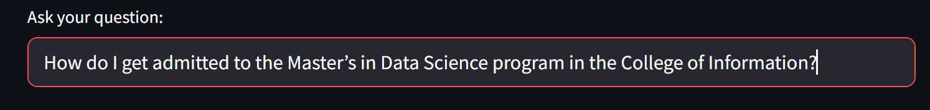
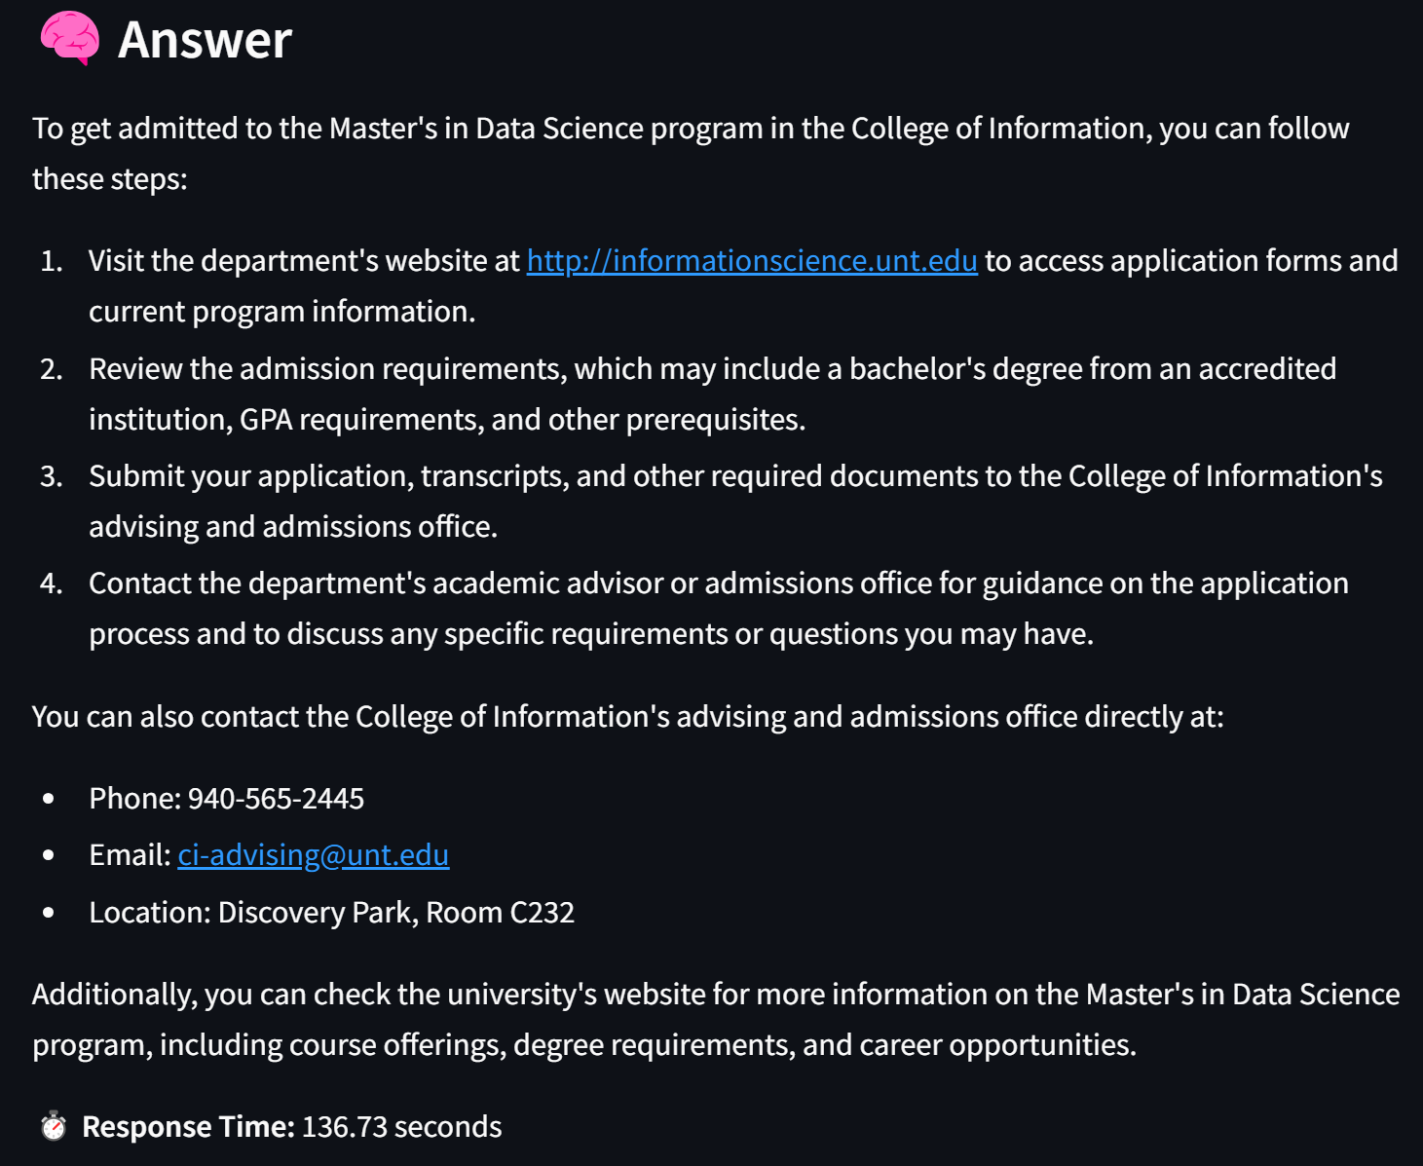
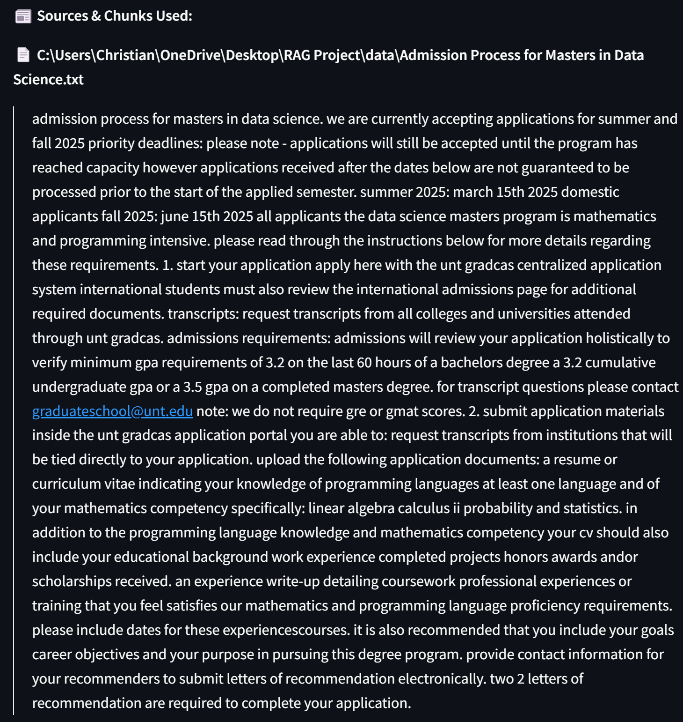
Results

Slide 25
Results
Advisor response: "https://datascience.unt.edu/programs/msds/admission.html Minimum GPA, background in math and programming. Leveling up courses for admission requirements."
Correctness: Incorrect
The OUTPUT introduces additional details about specific application steps, such as requiring letters of recommendation, entrance exams, and detailed descriptions of the program's structure and content. The REFERENCE only mentions a minimum GPA and a background in math and programming as parts of the admission requirements, which the OUTPUT does not directly reflect. Therefore, the OUTPUT contains information not present in the REFERENCE, altering the original meaning.
BERT Score = 0.64
Semantic Similarity = 0.76

Slide 26
Results
Context Quality: Valid
The text clearly outlines the admissions process for the Master's in Data Science program, including application deadlines, GPA requirements, required documents, and the process for submitting transcripts and letters of recommendation. It also provides information on how to apply, what materials are necessary, and mentions that GRE or GMAT scores are not required, which are all essential details for answering the question about admission.
Faithfulness: Unfaithful
The response contradicts the information provided in the source. Specifically, it mentions entrance exams (GRE or other) being required, but the source explicitly states that GRE or GMAT scores are not required for admission to the program. Additionally, it does not accurately reflect the specifics of the application steps and document requirements as outlined in the source.

Slide 27

More metrics
Time to generate answers - 98.54 to 354.76 seconds
(1 minute 38 seconds – 5 minuets 54 seconds)
Average time - 209.11 seconds (3 minutes 29 seconds)
Total time to answer all 14 questions - 2927.52 seconds (48 minutes 47 seconds)
For comparison human advising appointments are usually only 30 minutes but must be scheduled weeks in advance (depending on time of year). In my advising appointment, the advisor was able to provide general answers and links for 14 questions in about 20 minutes.

Slide 28
references
[1] Wolff, Hayden (2023, Dec. 18). Rag 101: Demystifying Retrieval-Augmented Generation Pipelines. Nvidia Developer. https://developer.nvidia.com/blog/rag-101-demystifying-retrieval-augmented-generation-pipelines/
[2] Samad, Abdul (2024, May 20). Agentic RAG Application using LlamaIndex – Router Query Engine. Medium. https://medium.com/@samad19472002/agentic-rag-application-using-llamaindex-router-query-engine-5b3f7b7feb75
[3] Tripathi, Rajat (2023, Jun. 30). What are Vector Embeddings. Pinecone. https://www.pinecone.io/learn/vector-embeddings/
[4] Bhoi, Debaprasann (2024, Feb. 11). ChromaDB: An Open-source vector database. Medium. https://blog.gopenai.com/chromadb-an-open-source-vector-database-f1871580b412

